Slide 1
Global Energy Consumption & Renewable Generation
Presented By:
Verina Fouad

Slide 2
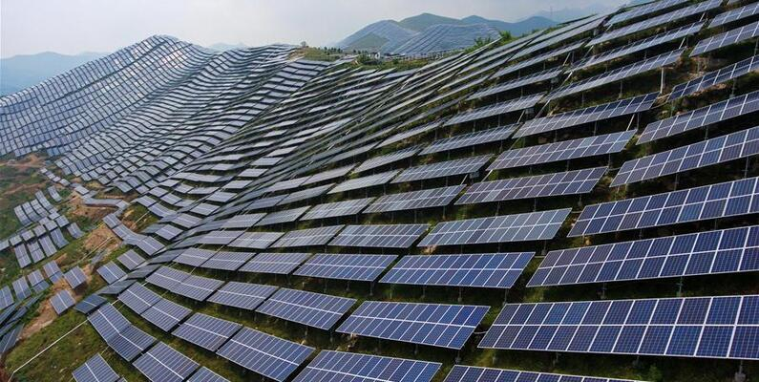
Extracting the Data
Data Description:
You can get data from Kaggle : https://www.kaggle.com/datasets/jamesvandenberg/renewable-power-generation/data
We have multiple datasets provided: Energy generation (TWH) by Continent and Country, along with renewable and non-renewable energy generation by continent and country. However, the renewable energy data is only available from the year 1997 to 2017. Divide Into Six Main Tables.

Slide 3
Extracting the Data
Objectives:
Look into the different energy datasets for the years 1997 to 2017 Clean and organize the datasets into more analyzable forms Perform EDA on each to discover trends and patterns join datasets to find more insights by EDA Use Classification and regression algorithms on different columns of data. This includes: Feature Selection Feature Engineering Comparison between multiple techniques Predictions (where applicable)
Inspiration:
Which types of renewables are improving the fastest? Which countries using which types of renewables? At the increasing rate of returns on renewables?

Slide 4
Data
Data Dictionary
1)The OECD: The Organisation for Economic Co-operation and Development (OECD) is a key international standard-setting organisation which conducts valuable independent analysis and statistics on a range of economic and other policy areas and it consists of 38 member countries (Australia, Austria, Belgium, Canada, Chile, Colombia, Czech Republic, Denmark, Estonia, Finland, France, Germany, Greece, Hungary, Iceland, Ireland, Israel, Italy, Japan, South Korea, Latvia, Lithuania, Luxembourg, Mexico, Netherlands, New Zealand, Norway, Poland, Portugal, Slovak Republic, Slovenia, Spain, Sweden, Switzerland, Turkey, United Kingdom, United States)
2)BRICS: Is an intergovernmental organization comprising nine countries: Brazil, Russia, India, China, South Africa. BRICS was originally identified to highlight investment opportunities. (Iran, Egypt, Ethiopia, and the United Arab Emirates) Added recently so, we didn't include them.
3)CIS: The Commonwealth of Independent States (CIS) is a regional intergovernmental organization in Eurasia and it consists of 38 member countries(Armenia, Azerbaijan, Belarus, Kazakhstan, Kyrgyzstan, Moldova, Russia, Tajikistan, Turkmenistan, Uzbekistan)
4)TWh: Referes to Terawatt hour and it is a unit of energy used for expressing the amount of produced energy

Slide 5

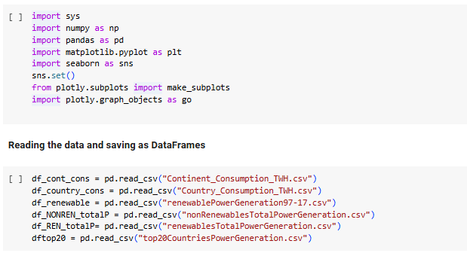
Extracting the Data
Cleaning, Prepare & Modify Using Python:
Importing the libraries and the tables One:
https://colab.research.google.com/drive/1csujoe88CU2IdIO7kdBZS_Gh5wtWkqH5#scrollTo=QJIdx8yrZMen

Slide 6
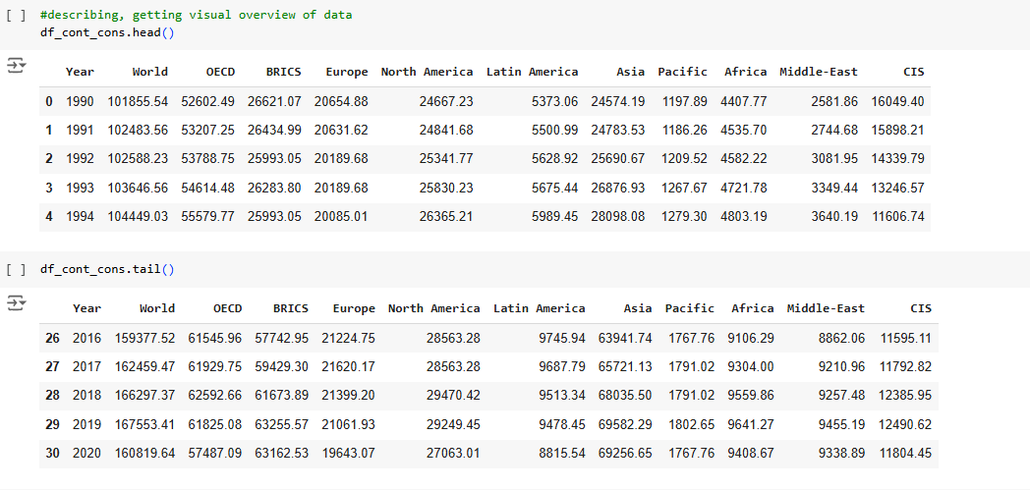
Extracting the Data
Cleaning, Prepare & Modify Using Python:
Getting Visuals table One:

Slide 7
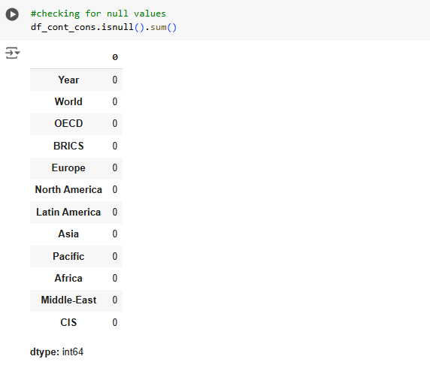
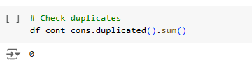
Extracting the Data
Cleaning, Prepare & Modify Using Python:
Checking For Nulls & Duplicates in table One:

Slide 8
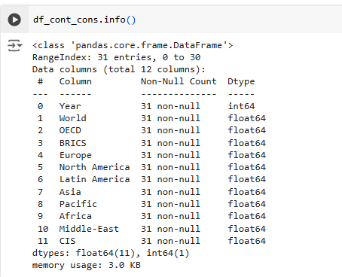
Extracting the Data
Cleaning, Prepare & Modify Using Python:
Info Of table One:

Slide 9

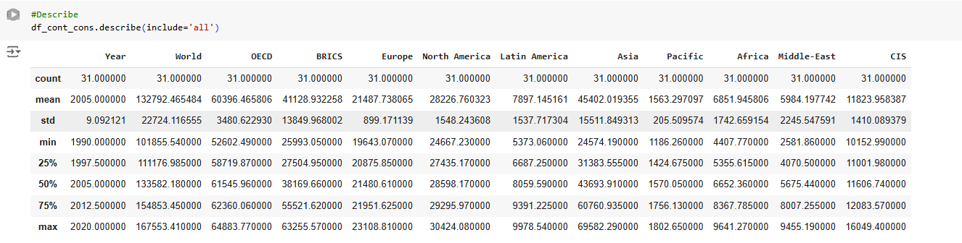
Extracting the Data
Cleaning, Prepare & Modify Using Python:
Describing table One:

Slide 10
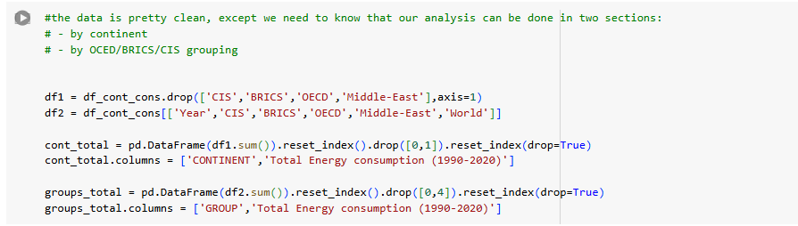
Extracting the Data
Cleaning, Prepare & Modify Using Python:
Divided table One into Two Tables:

Slide 11
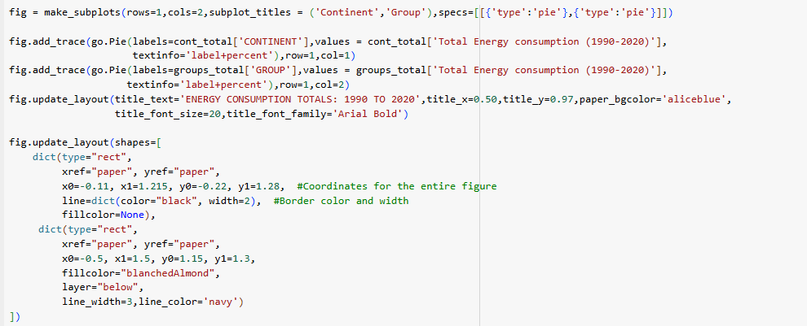
Extracting the Data
Cleaning, Prepare & Modify Using Python:
Compare the new Two Tables:

Slide 12
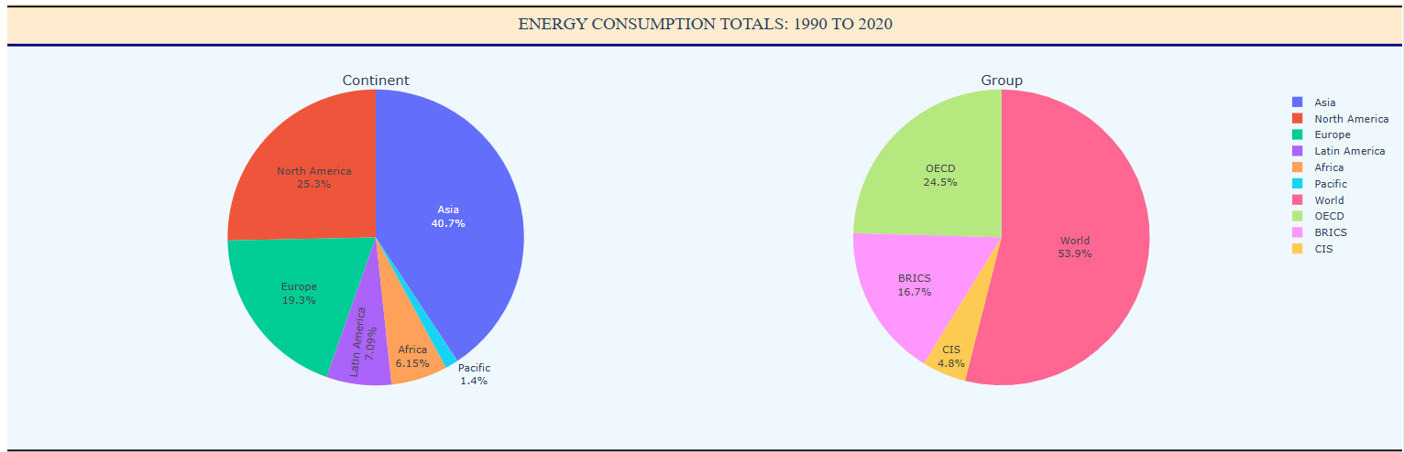
Extracting the Data
Cleaning, Prepare & Modify Using Python:
Compare the new Two Tables:

Slide 13
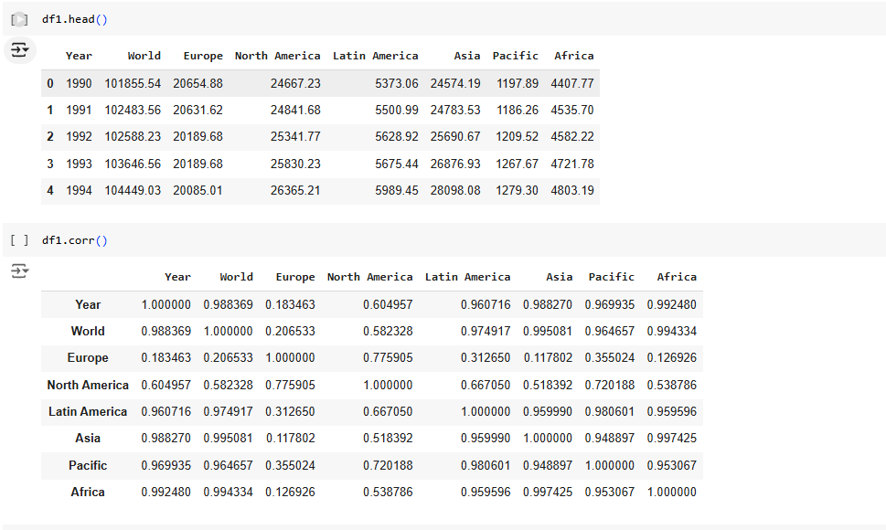
Extracting the Data
Cleaning, Prepare & Modify Using Python:
Analysis of each table of the new Two Tables:
Df1:

Slide 14
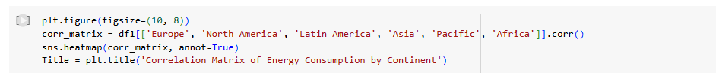
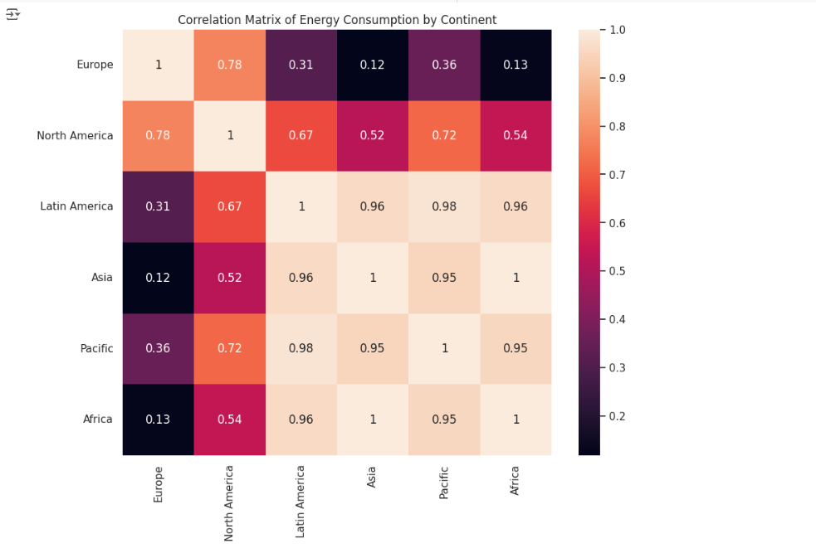
Extracting the Data
Cleaning, Prepare & Modify Using Python:
Df1:

Slide 15
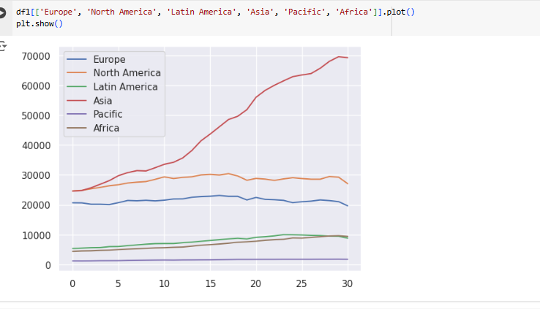
Extracting the Data
Cleaning, Prepare & Modify Using Python:
Df1:

Slide 16
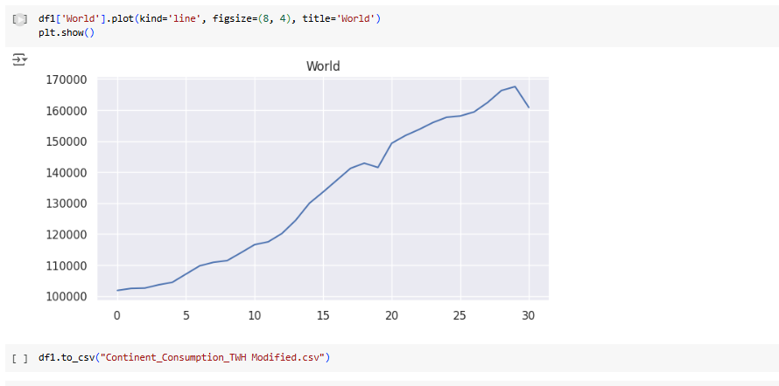
Extracting the Data
Cleaning, Prepare & Modify Using Python:
Df1:

Slide 17
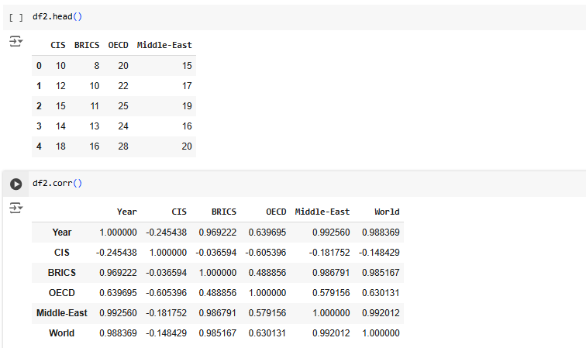
Extracting the Data
Cleaning, Prepare & Modify Using Python:
Df2:

Slide 18
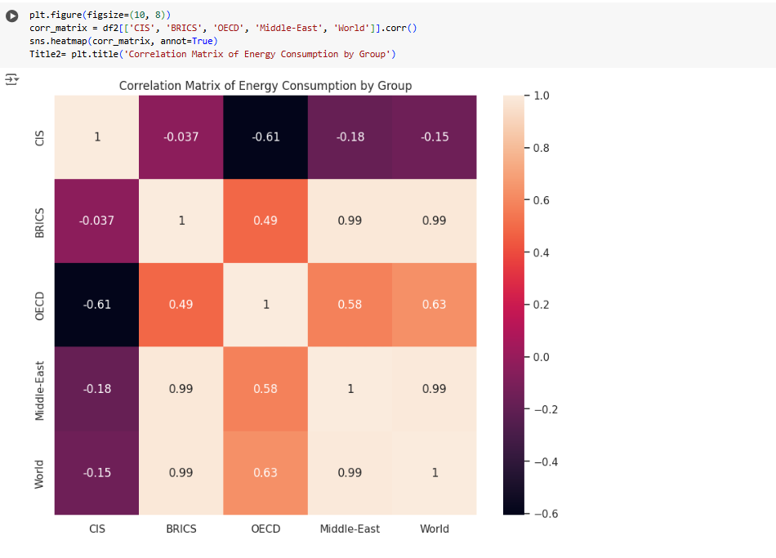
Extracting the Data
Cleaning, Prepare & Modify Using Python:
Df2:

Slide 19
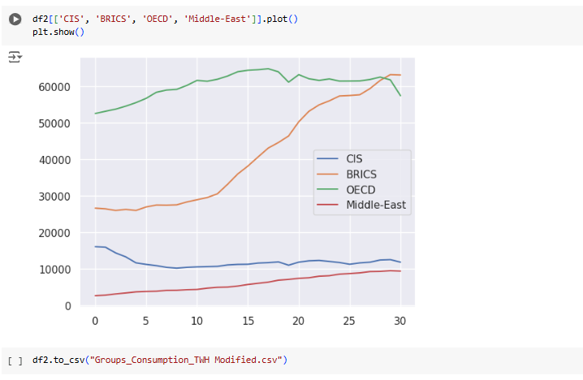
Extracting the Data
Cleaning, Prepare & Modify Using Python:
Df2:

Slide 20
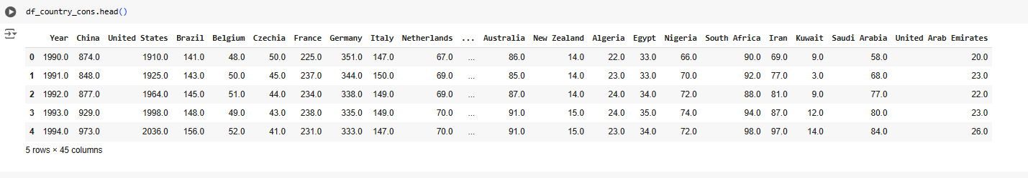
Extracting the Data
Cleaning, Prepare & Modify Using Python:
Table 2:

Slide 21
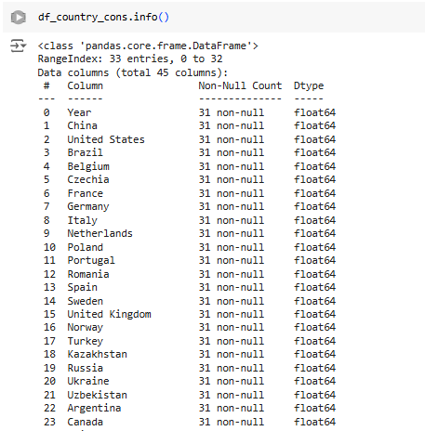
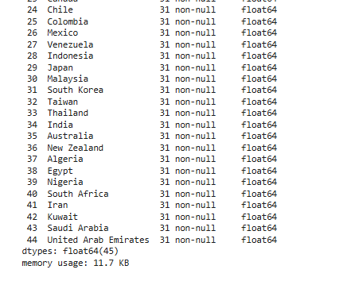
Extracting the Data
Cleaning, Prepare & Modify Using Python:
Table 2:

Slide 22
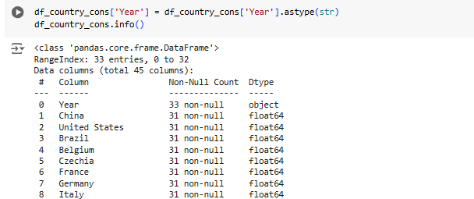
Extracting the Data
Cleaning, Prepare & Modify Using Python:
Table 2:

Slide 23
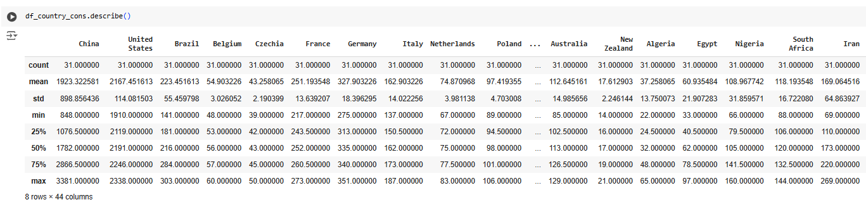
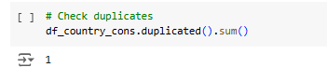
Extracting the Data
Cleaning, Prepare & Modify Using Python:
Table 2:

Slide 24
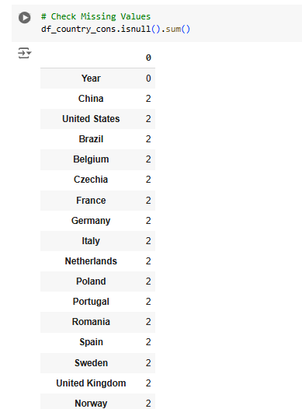
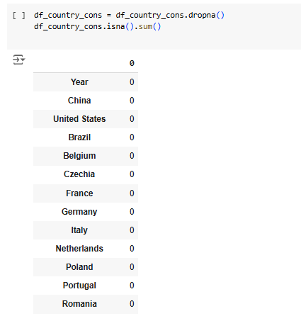
Extracting the Data
Cleaning, Prepare & Modify Using Python:
Table 2:

Slide 25
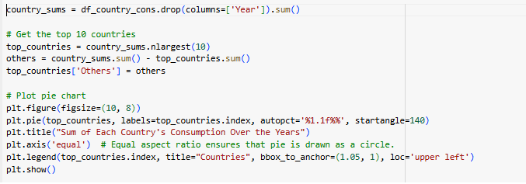
Extracting the Data
Cleaning, Prepare & Modify Using Python:
Table 2:

Slide 26
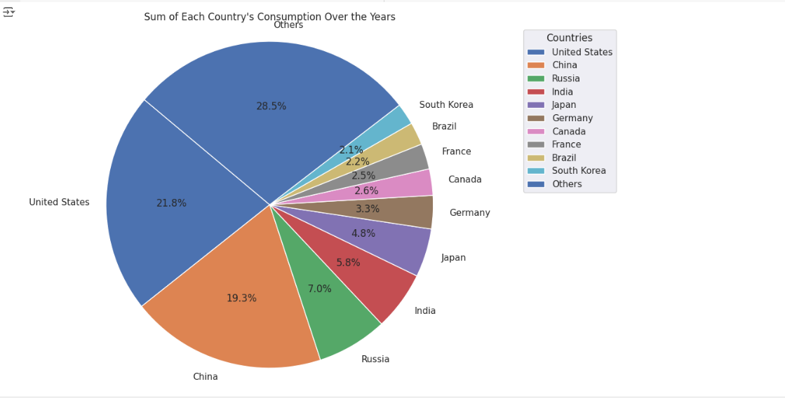
Extracting the Data
Cleaning, Prepare & Modify Using Python:
Table 2:

Slide 27
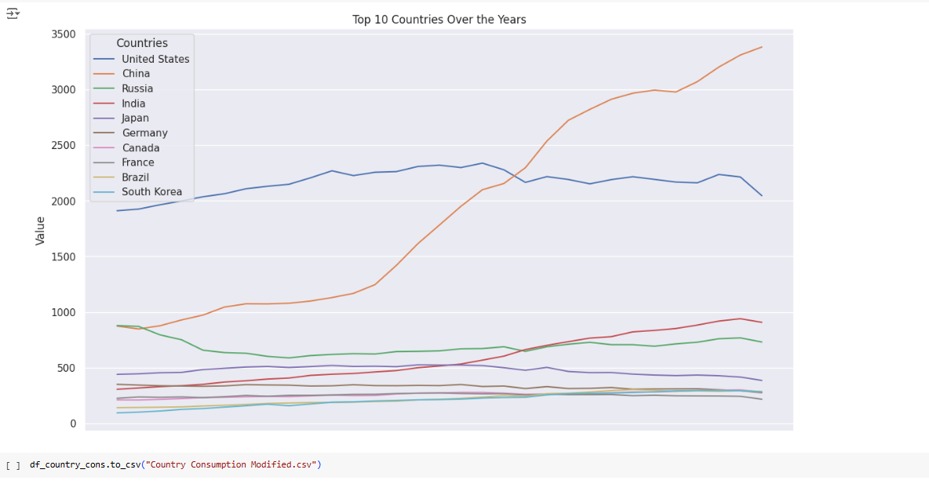
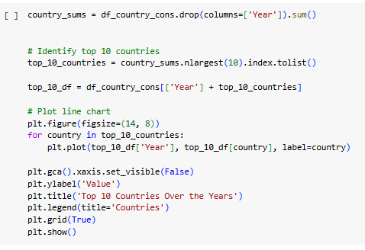
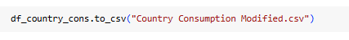
Extracting the Data
Cleaning, Prepare & Modify Using Python:
Table 2:

Slide 28
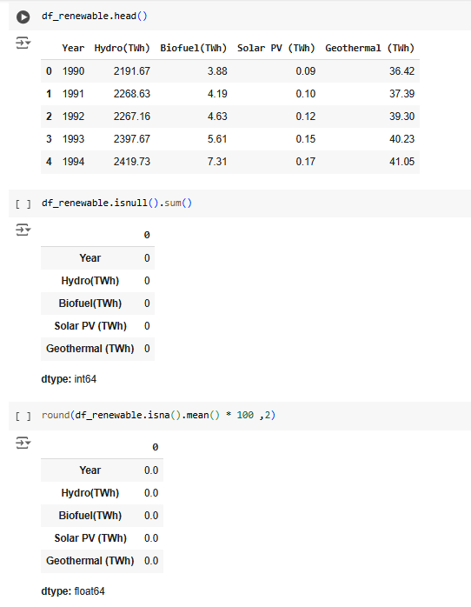
Extracting the Data
Cleaning, Prepare & Modify Using Python:
Table 3:

Slide 29
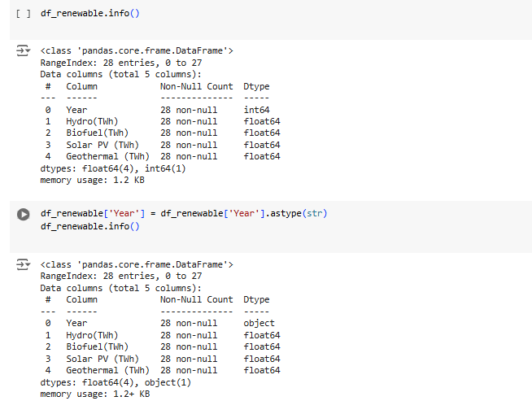
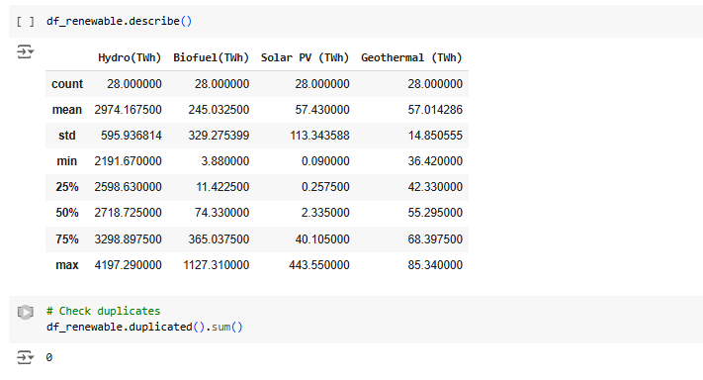
Extracting the Data
Cleaning, Prepare & Modify Using Python:
Table 3:

Slide 30
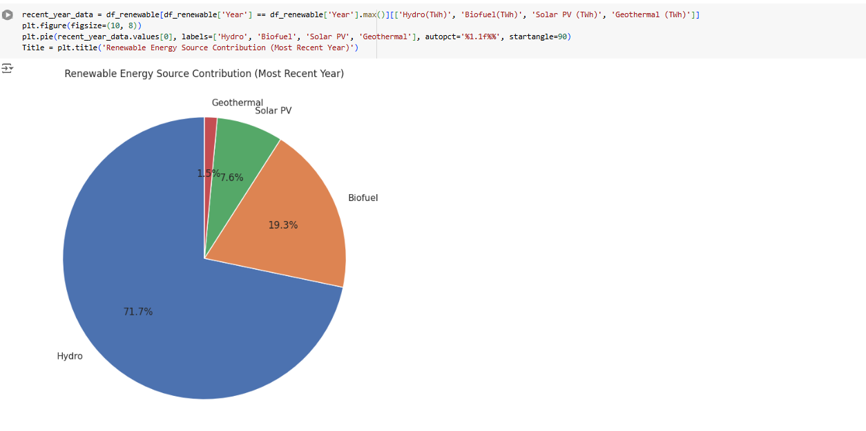
Extracting the Data
Cleaning, Prepare & Modify Using Python:
Table 3:

Slide 31
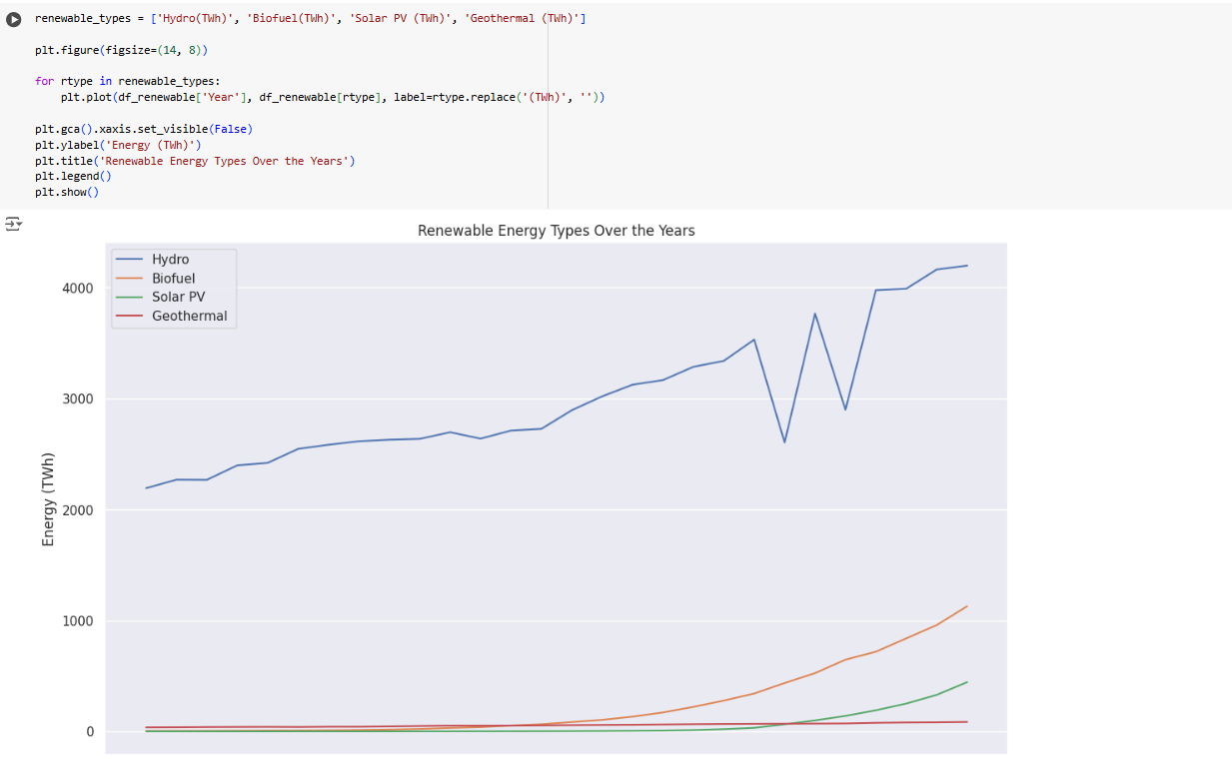
Extracting the Data
Cleaning, Prepare & Modify Using Python:
Table 3:

Slide 32
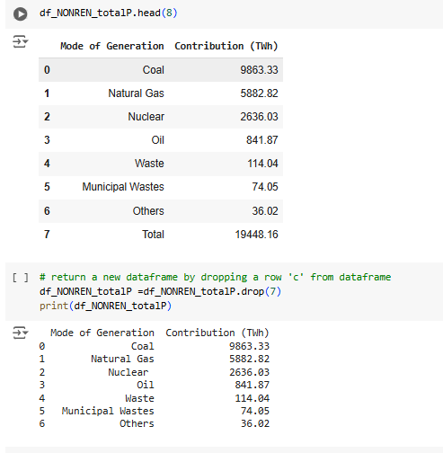
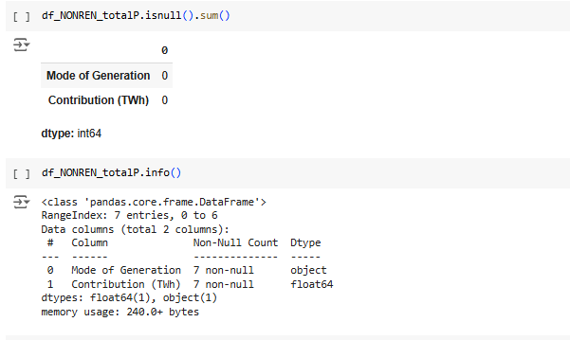
Extracting the Data
Cleaning, Prepare & Modify Using Python:
Table 4:

Slide 33
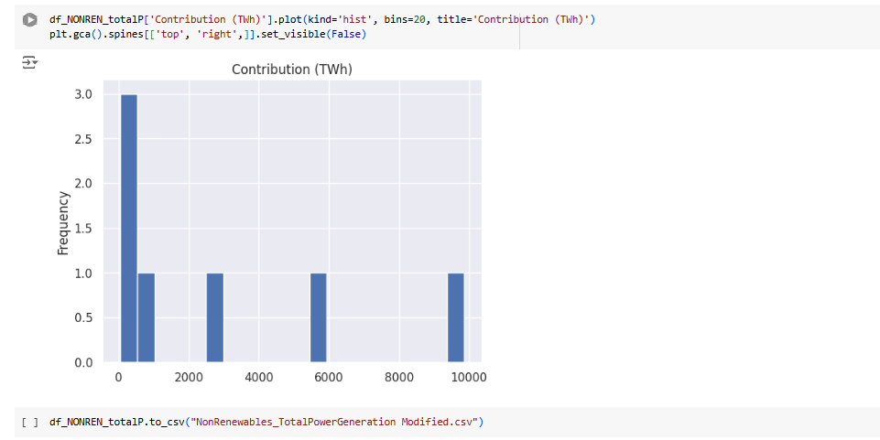
Extracting the Data
Cleaning, Prepare & Modify Using Python:
Table 4:

Slide 34
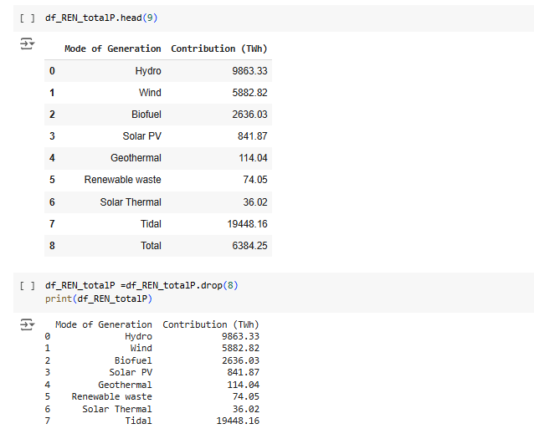
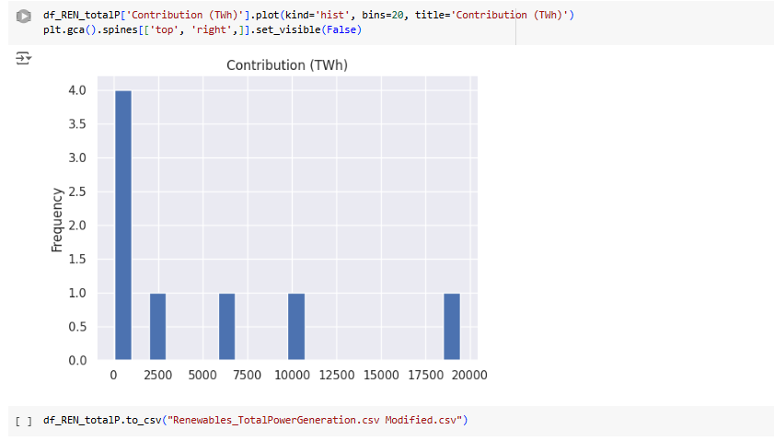
Extracting the Data
Cleaning, Prepare & Modify Using Python:
Table 5:

Slide 35
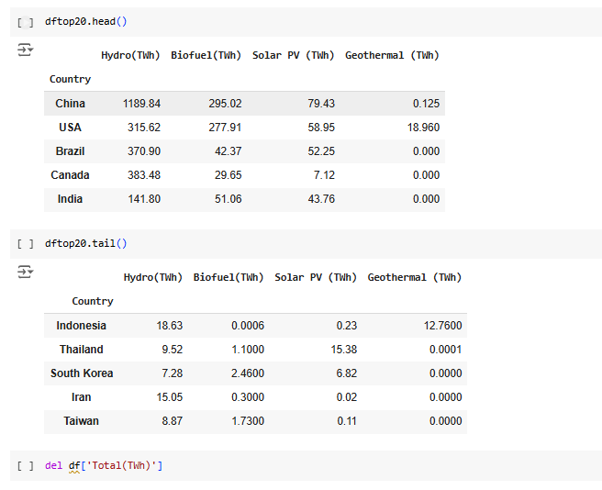
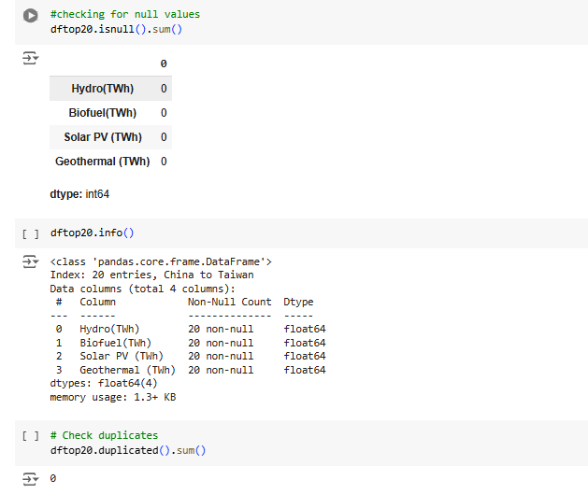
Extracting the Data
Cleaning, Prepare & Modify Using Python:
Table 6:

Slide 36
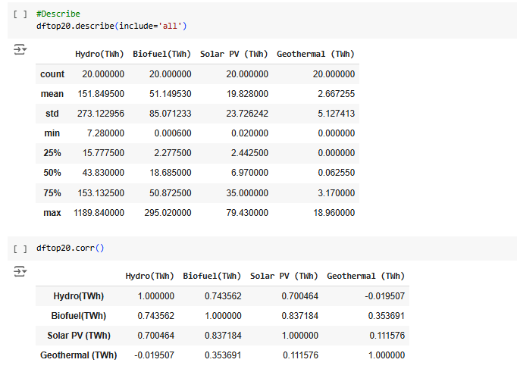
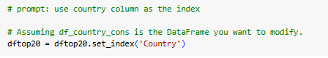
Extracting the Data
Cleaning, Prepare & Modify Using Python:
Table 6:

Slide 37
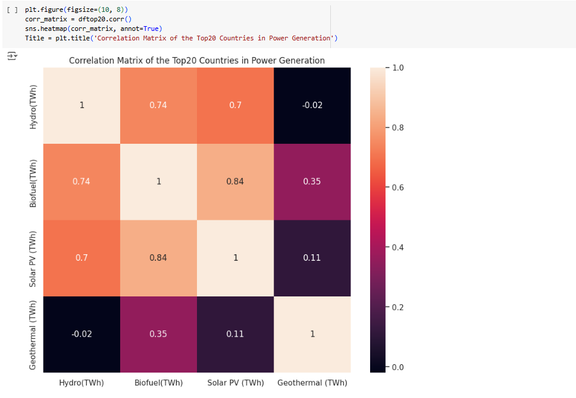
Extracting the Data
Cleaning, Prepare & Modify Using Python:
Table 6:

Slide 38
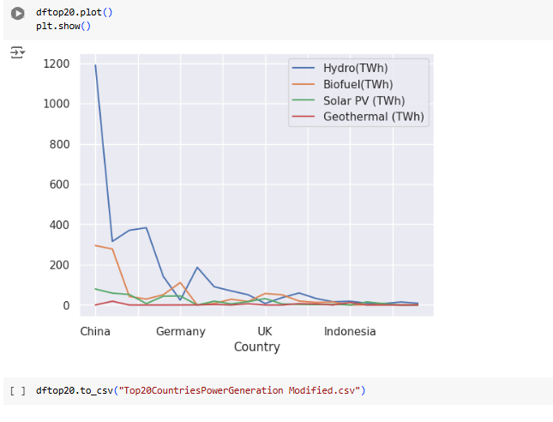
Extracting the Data
Cleaning, Prepare & Modify Using Python:
Table 6:

Slide 39

Power BI Analysis:
Power Query:
Removed any Columns Expect The Year & World’s Consumption to Make it as My Dim table
Made a Fact Table Using the Continent’s Data & Years
Unpivot for The Continent’s Data
Made the Same for the Groups Table & Countries Table & Renewable_PowerGeneration and Renamed their columns
Made an Append to Gather the Renewable & Non-Renewable Tables data.
Made the Close&Apply step

Slide 40
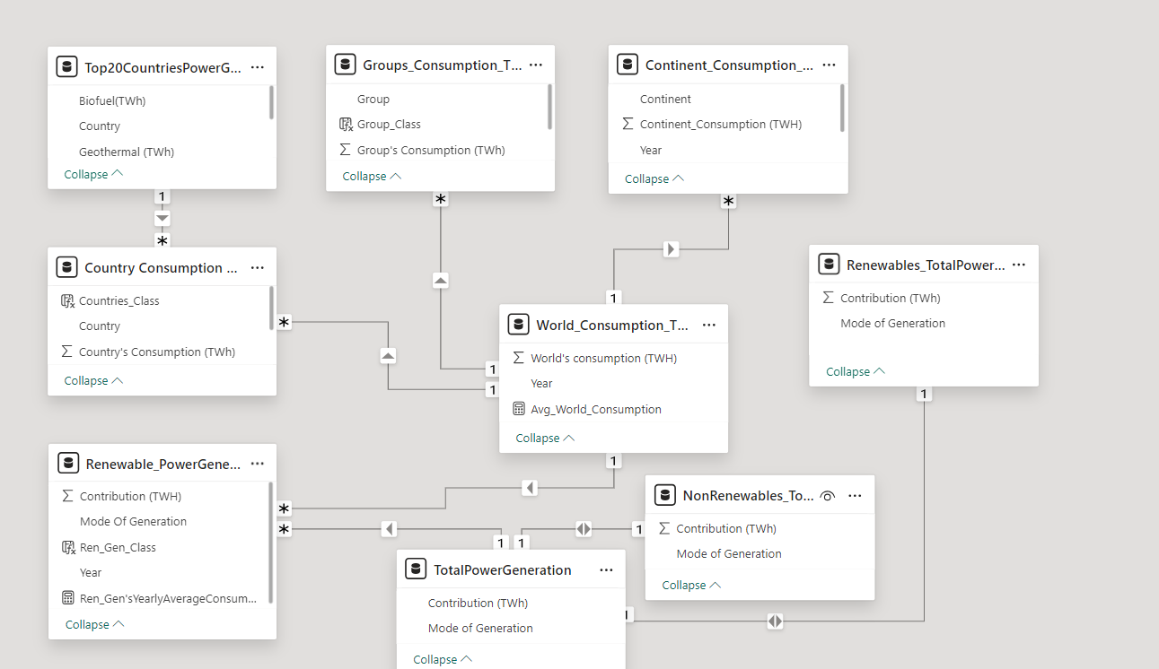
Power BI Analysis:
Model View:

Slide 41
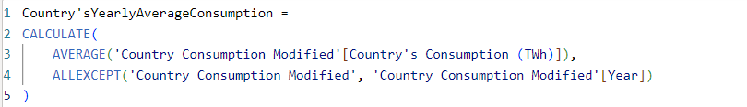
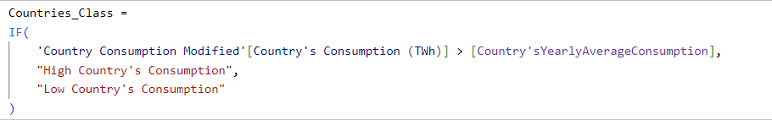
Power BI Analysis:
Table View:
Started to add measures and columns

Slide 42


Power BI Analysis:
Table View:

Slide 43

Power BI Analysis:
Report View:

Slide 44


